Slide 1
Work chances in our region
Presentation by Jonas and Yannick, Christian-Gymnasium Hermannsburg

Slide 2
Structure
geographical location
our landscape
unemployment rate in our region
unemployment rate in comparison to Berlin
reasons for youth unemployment
biggest companies in our region
the church as an employer
“Bundeswehr” (German armed forces) as an employer
conclusion

Slide 3
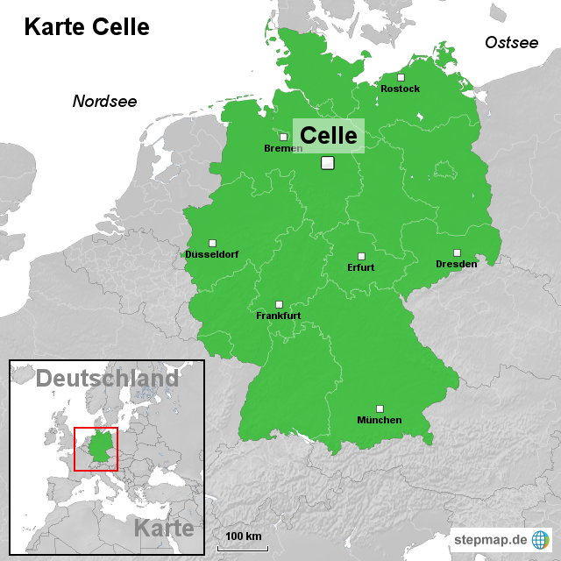
Geographical location

Slide 4


Slide 5


Slide 6
Unemployment rate in our region

Slide 7
Unemployment rate in Berlin

Slide 8
Unemployment rate in Spain

Slide 9
Reasons for youth unemployment
our county is agrarian oriented so the employers are only in the big cities
a majority of the unemployed young people is under age so they have no chance to travel to a job a few kilometers away
it´s not possible for the local farming companies to employ enough young people
advertising is not really sponsored enough so young people don‘t know that there is a chance to get a job

Slide 10
Most important employers in the region
Baker Hughes :
founded in 1987
one of the largest oil field services
headquarter in Housten
employed people : 58.500 (2011)
generated money : 17.7 Mrd Euro (2011)

Slide 11
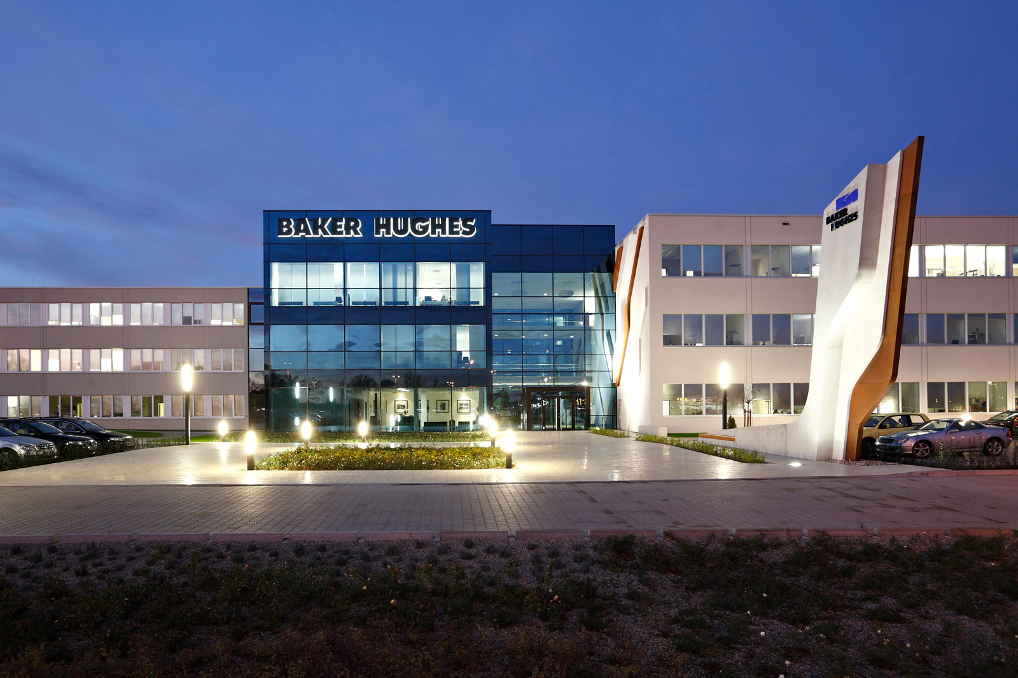
Baker Hughes in Celle

Slide 12
Why there is a big oil company in Celle:
1859 first finding of oil in Wietze near Celle
first oil promotion in the world
1910 over 80% of German oil came from Wietze
today, the company mainly produces cell drill tools and engines

Slide 13
Rheinmetall:
founded in 1889
headquarter in Düsseldorf , Germany
automotive and military technology group
employed people : 20,264 (2012)
generated money : 4,454 bn Euro (2012)

Slide 14
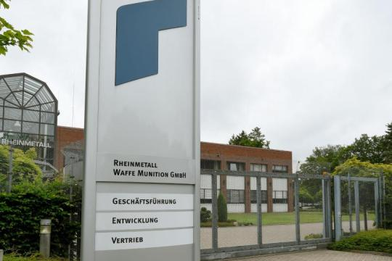
Rheinmetall AG (Unterlüß)

Slide 15
Fields of education
industrial merchant
industrial mechanic
technical product designer
cutting machine operator
mechatronic technician

Slide 16
The church as an employer
the church plays an important role in the economic system of Hermannsburg
a lot of shops have the church as a background
Ludwig Harms Haus: meeting point and library with fair trade products
two kindergartens
the church is a big topic in Hermannsburg and important for our local community - and economy in general

Slide 17
Bundeswehr (German armed forces) as an employer
teaches dicipline
results in enhancement of productivity in the later sections of life
there are a lot of ways the many fields of work fight the unemployment of youth
really present in our region so young people can decide between a lot of army base camps
they must enlist themselves for a few years, afterwards they earn good money and free housing

Slide 18
Fields of education
electrician
turbine mechanic
administrative officer
communication technician
measuring technician
photographer
mechatronic technician
informatics merchant

Slide 19
It depends on the people if they really want to get a job and if they can make compromises .

Slide 20
Thank´s for your attention

