Slide 1
Letter of application and CV in Germany
From Anna, Hannah, Bianca

Slide 2
Structure
An application …
Our companies
Curriculum Vitae
- our examples
Letter of application
- our examples
What to improve?

Slide 3
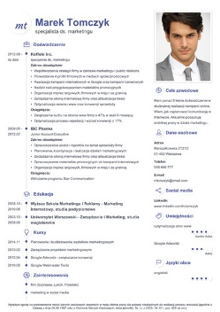
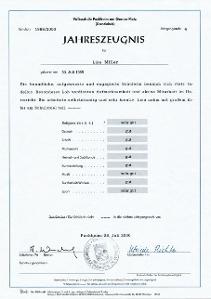
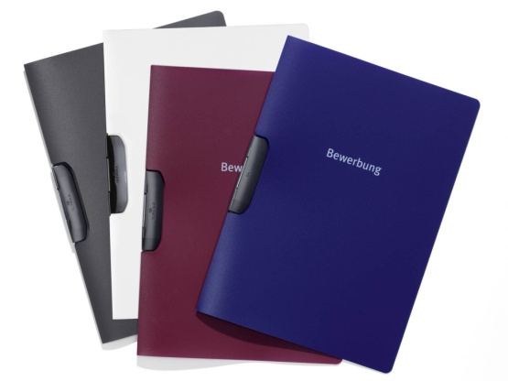
An application…
Letter of application
Curriculum Vitae
Certificates
The right folder

Slide 4
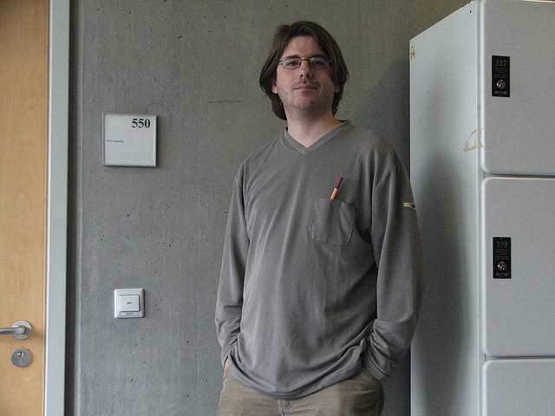
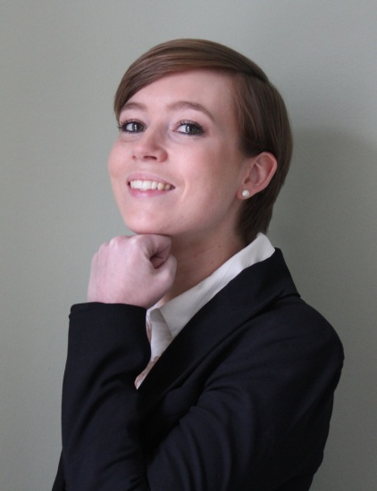
An application The right photo
6 x 4 or 9 x 6 centimeters

Slide 5
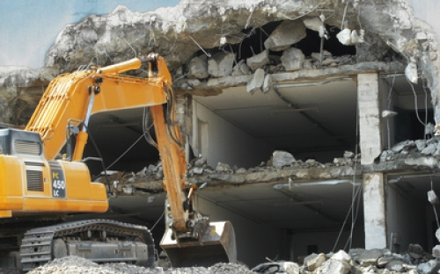
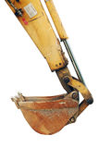
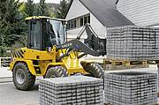
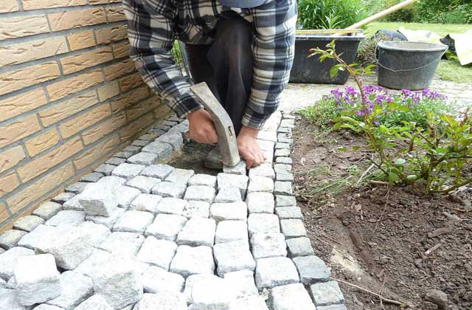
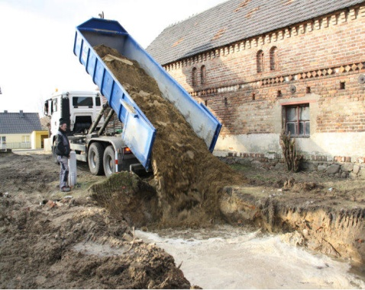
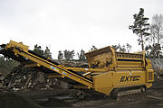
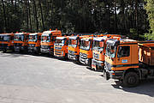
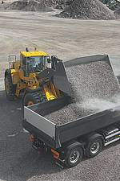
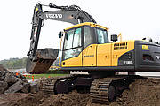
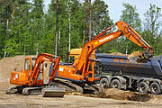
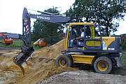
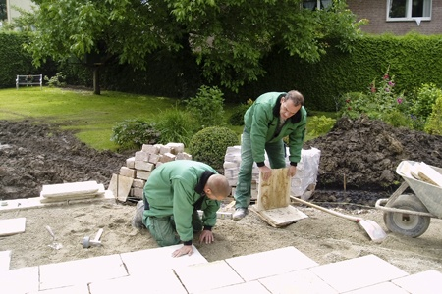
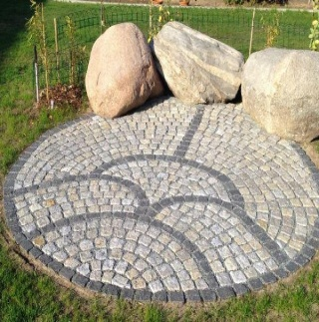
Our companies
Wedau - Haulage Company GmbH and Co. KG
- excavation work
- demolition work
- gardening

Slide 6
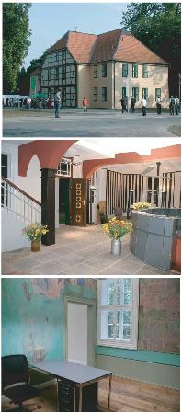
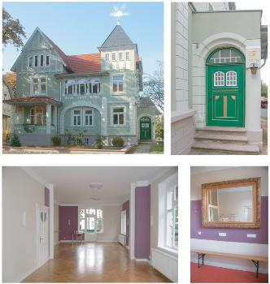
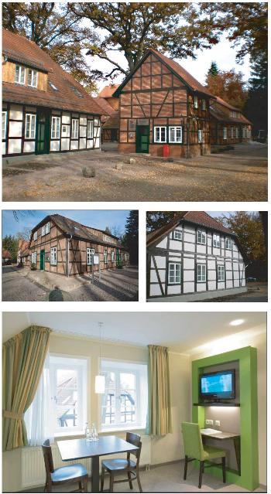
Our companies
County Manor Eicklingen
Villa Edith
Hotel at the Cloister

Slide 7
Curriculum Vitae
Part 1 Picture
Personal information
Name: Anna Lena Bakemeier
Address: Im Alten Dorf 2, 29303 Bergen
Date of birth: 16.10.1997
Birthplace: Lüdenscheid
Parents: Andre Bakemeier, pedagogical assistant
Nadine Bakemeier, radiographer
Brothers and sisters: Emi Marie Bakemeier, 14 years
Finn Lewin Bakemeier, 10 years

Slide 8
Curriculum Vitae
Part 2
School career
2007-2011 Grundschule Eversen (primary school)
Since 2011 Christian-Gymnasium Hermannsburg
2019 general qualification for university
Practical activities
private lessons in Math
voluntary work with children and teenagers

Slide 9
Curriculum Vitae
Part 3
Language skills
English
Latin
Further qualifications
internship as gardener for two weeks
youth-leader certificate
Personal interests
football
dancing
Date
Bergen, 23 April 2016

Slide 10
Our examples Curriculum vitae
Curriculum Vitae
Personal information
Name: Anna Lena Bakemeier
Address: Im Alten Dorf 2, 29303 Bergen
Date of birth: 16.10.1997
Birthplace: Lüdenscheid
Parents: Andre Bakemeier, pedagogical assistant personal information
Nadine Bakemeier, radiographer
Brothers and sisters: Emi Marie Bakemeier, 14 years
Finn Lewin Bakemeier, 10 years
School career
2007-2011 Grundschule Eversen (primary school)
Since 2011 Christian – Gymnasium Hermannsburg Europaschule school career
2019 expected: general qualification for university (A-level)
Practical activities
giving privat lessons in math
voluntary work with children and teenager practical activities
Language skills
English
Latin language skills
Further qualifications
internship as gardener for two weeks
youth – leader certificate further qualifications
Personal interests
football
dancing personal interests
Bergen, 23 April 2016 date

Slide 11
Letter of application
Part 1
Address of the addresser
Hannah Prilop
Scheelenstraße 5
29303 Bergen
Tel.: 05051/8724
E-Mail: hannah.prilop@gmx.de
Address of the addressee
Dipl. Ing. Karsten Stumpf, Freier Architekt Schuhstraße 16
29221 Celle

Slide 12
Letter of application
Part 2
Date
Bergen, 24.04.2016
Heading
Application for an apprenticeship as an architectural draftsman
Salutation
Dear Mr. Stumpf,
Introduction – Why are you writing?
my name is Hannah Prilop, I am 16 years old and in the 10th grade of the Christian Highschool in Hermannsburg. In summer 2016 I expect to finish school with Advanced secondary education.

Slide 13
Letter of application
Part 3
Main part – Why are you the right person for this job?
I would like to apply for the apprenticeship as architectural draftsman, which you are advertising on your website. I love to draw and take pictures and am interested in architecture and architectural history. In school my work is creative and precise. My teacher also praises my diverse interests and my openness to new things.
As you can see from my enclosed resumѐ, I have already done work experience at a construction company in Hamburg last year. There I was able to look over the shoulder of the drafters and see how a district is redesigned. Thus I have already received a first insight into the workplace.
If I were to describe myself, I would say I am team player, resilient, committed and reliable. In my spare time I dance, sing and play piano and meet up with friends to be creative together.

Slide 14
Letter of application
Part 4
Friendly ending
Thank you for taking the time to read my application. Hoping for a positive response on your part and a possible interview.
Regards
Yours sincerely
Signature
Hannah Prilop
Attached
Attached: CV

Slide 15
Our examples Letter of application
Hannah Prilop
Scheelenstraße 5
29303 Bergen
Tel.: 05051/8724
E-Mail: hannah.prilop@gmx.de
Dipl. Ing. Karsten Stumpf, Freier Architekt Schuhstraße 16
29221 Celle
Bergen, 24.04.2016
Application for an apprenticeship as an architectural draftsman.
Dear Mr. Stumpf,
My name is Hannah Prilop, I am 16 years old and in the 10th grade of the Christian Highschool in Hermannsburg. In summer 2016 I expect to finish school with Advanced secondary education.
I would like to apply for the apprenticeship as architectural draftsman, which you are advertising on your website. I love to draw and take pictures and am interested in architecture and architectural history. In school my work is creative and precise. My teacher also praises my diverse interests and my openness to new things.
As you can see from my enclosed resumѐ, I have already done work experience at a construction company in Hamburg last year. There I was able to look over the shoulder of the drafters and see how a district is redesigned. Thus I have already received a first insight into the workplace.
If I were to describe myself, I would say I am team player, resilient, committed and reliable. In my spare time I dance, sing and play piano and meet up with friends to be creative together.
Thank you for taking the time to read my application. Hoping for a positive response on your part and a possible interview.
Yours sincerely
Hannah Prilop
Attached: CV
Address of the addresser
Address of the addressee
Date
Heading
Salutation
Introduction – Why are you writing?
Main part – Why are you the right person for this job?
Friendly ending
Regards
Signature
Attached

Slide 16
Our feedback

Slide 17
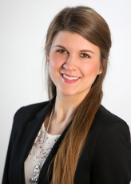
What to improve? Curriculum Vitae
1. quality of the picture
2. outward appearance (positive impression?)
3. clean white paper, no dog ears
4. faultless German
5. prevent typing errors and spelling mistakes
6. correct paperformat (DinA4)
7. include work experience in respective field/area
8. language skills
9. further education
10. refer to the cooperation
11. fond size 12 (hello, hallo, ciao, cześć, hoi)

Slide 18
What to improve? Letter of application
“The letter of application is a possible entry to get a good job!“
1. ordinary paper
2. at the beginning “Dear Sir or Madame“ (a plus if you know the name)
3. one concise, formal sentence at the beginning, to attract attention
4. not longer than 1 Din A4 page!
5. date (day, month, year)
6. handwritten name under the regards
7. documents have to be faultless
8. unfolded into a big envelope
9. you should never say that the job is only a stopover for a next one

