Slide 1
Free mobility in our region

Slide 2
Going abroad from poland before 1989
Our borders were closed
If you wanted to go to abroad, you had to have a passport which was very hard to get
If you had a passport you could go mostly to communist countries, going to capitalistic ones was really hard
After you came back from abroad you had to report back
Most people who were lucky to go abroad were on business trips or were associated with the communist party
Poland in EU - 2004

Slide 3
Polish students abroad
advantages
disadvatages
After studying abroad we have more opportunities to find jobs
We can get better paid jobs
Our horizons broaden
We can get in touch with new cultures and customs
If someone decides to study abroad they can get help with getting to certain university
Most people after going abroad don’t come back to Poland
Studying abroad is expensive
If you want to push yourself forward abroad you have to work really hard for it

Slide 4
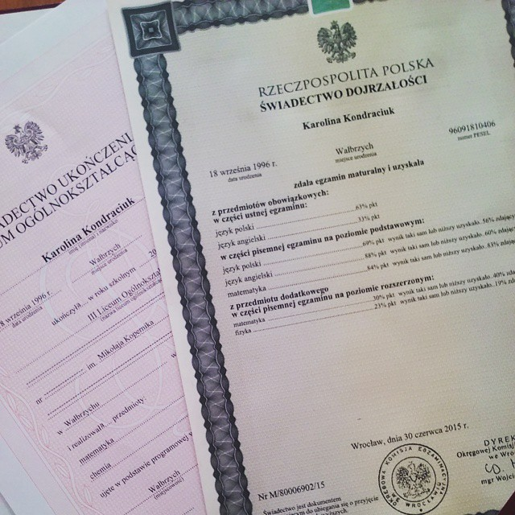
Polish diplomas in other countries
Most foreign countries accept our exam while entering the university
Sometimes you also need a certificate to prove your language skills
Not all foreign employers accept Polish diplomas

Slide 5
Polish people working abroad
advantages
disadvatages
No people to work, desolating city
Slower progress because people with ideas and competence go away
Best qualified workers leave
There is more competition for working place abroad
People leave behind their families
People can develop their language and general skills
People who work abroad gain more money because their salary is higher
We can get in touch with new cultures and customs
If our people have ideas they fulfil them abroad with more chance of publicity
Poeple working abroad support their family in Poland financially

Slide 6
FOREIGNERS IN OUR REGION
advantages
disadvatages
By buying things in our shops they power our economy
Białowieża Forest is place where a lot of foreign scientists come to do research or some sort of examination
Thanks to Białowieża Forest tourism in our region is developing
Workplaces are being taken by foreign employees who will be paid less than locals
Foreigners usually do not mix with local people
They don’t pay VAT

Slide 7
Thank you for your attention! ☺

